Slide 1
Anyone Like to Fly?
IST 718 – Big Data Analytics
Assignment – Final Project
Presenter(s) – Sana Khan | Michael Morrey | Ryan Tervo
Notes:
1. problem
2. visualizations
3. model selection
4. recommendation
5. next steps
I think we'll be good

Slide 2
OVERVIEW
Aviation Background
Business Understanding
Data Understanding, Preparation, and Visualization
Models
Model Result(s)
Conclusion
Epilogue
Notes:
problem
visualizations
model selection
recommendation
next steps
I think we'll be good

Slide 3
Aviation & Bureau of Transportation Background
U.S. Commercial Aviation Annual Revenue is approx. $250B.
Average Daily Flights 45,000
Average Daily Passengers 2,900,000
Travelers who want to be on time 100%
Flights that are typically on time? 79%
Bureau of Transportation Statistics
Keeps Meticulous Records
Hired US(startup) to create “Early Warning System”

Slide 4
Business Understanding
US(startup) Hired To Create a model to predict late flights
Part of a “Pilot” Program!
Airlines & Airports will try to proactively address issues.
Challenge in Context!
Daily Flights 45,000
Public Airports 5,211
Group III Airlines ($1B / yr) 19
Notes:
Airline - Group III: Annual revenue over $1B dollars

Slide 5

Business Understanding cont.
Why try to model something so complex?
In the immortal words of John F. Kennedy…
Notes:
This course is called Big Data.
Consider this our Moon Landing!

Slide 6
Data Understanding
Flight data is from 2019: Dataset is from Kaggle (of course!)
Approx 6.5 million flights with 28 Variables, 15 of interest
Outcome: 'DEP_DEL15'
Potential Predictor Variables:
Manpower
FLT_ATTENDANTS_PER_PASS
GROUND_SERV_PER_PASS
Airport / Airline
DEPARTING_AIRPORT
AIRPORT_FLIGHTS_MONTH
AIRLINE_FLIGHTS_MONTH
CONCURRENT_FLIGHTS
AVG_MONTHLY_PASS_AIRPORT
PLANE_AGE
Time
MONTH
DAY_OF_WEEK
DEP_TIME_BLK
Weather
Precipitation
SNWD (depth)
SNOW
TMAX
Notes:
'DEP_DEL15‘
'DISTANCE_GROUP‘
‘SEGMENT_NUMBER‘
'CONCURRENT_FLIGHTS‘
'NUMBER_OF_SEATS‘
'CARRIER_NAME‘
'AIRPORT_FLIGHTS_MONTH',
'AIRLINE_FLIGHTS_MONTH',
'AIRLINE_AIRPORT_FLIGHTS_MONTH',
'AVG_MONTHLY_PASS_AIRPORT',
'AVG_MONTHLY_PASS_AIRLINE',
'PLANE_AGE',
'DEPARTING_AIRPORT',
'PREVIOUS_AIRPORT',
'PRCP',
'SNOW',
'SNWD',
'TMAX',
'AWND',
'LATITUDE',
'LONGITUDE',

Slide 7
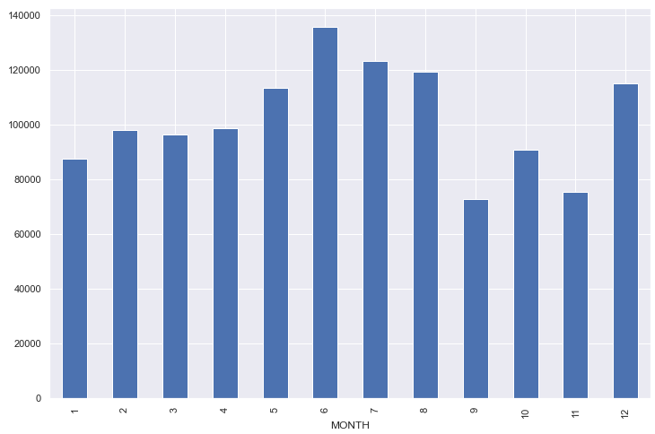
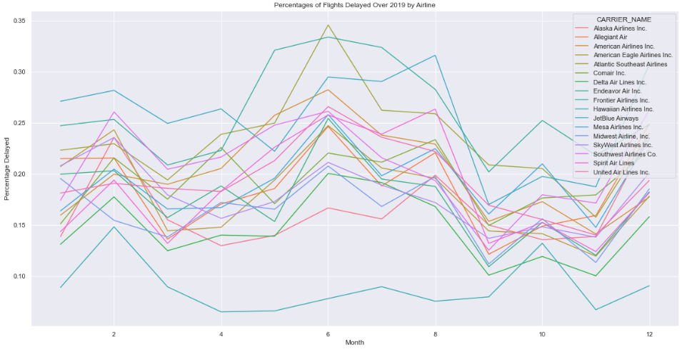
Data Understanding cont.
Total Delays by Month
% of Flight Delays Over Time by Airline
Summer months and December experience highest delays
Airlines can vary in months where delays are happening

Slide 8
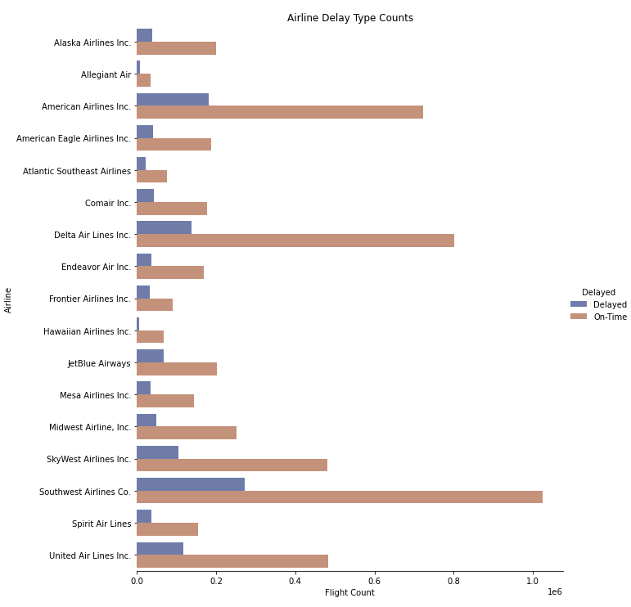
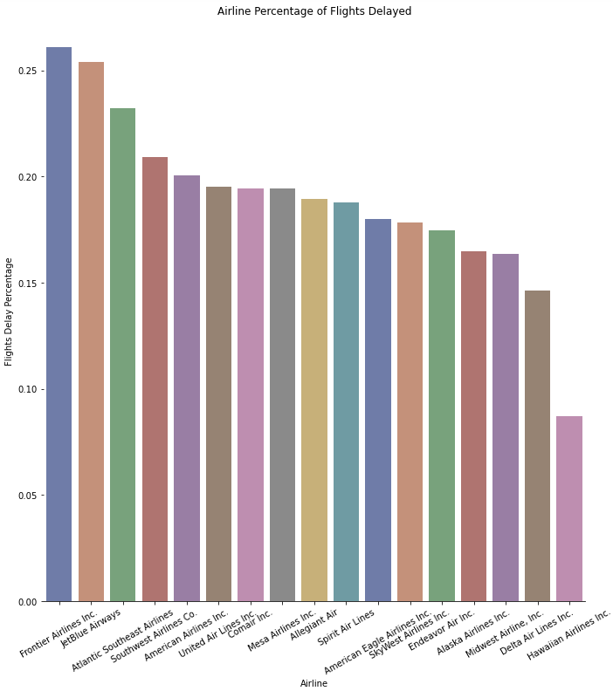
Data Understanding cont.
Despite more overall flights, Delta, Southwest, and American have relatively low percentage of flights delayed
Jet Blue and Frontier experience delays the most frequently

Slide 9
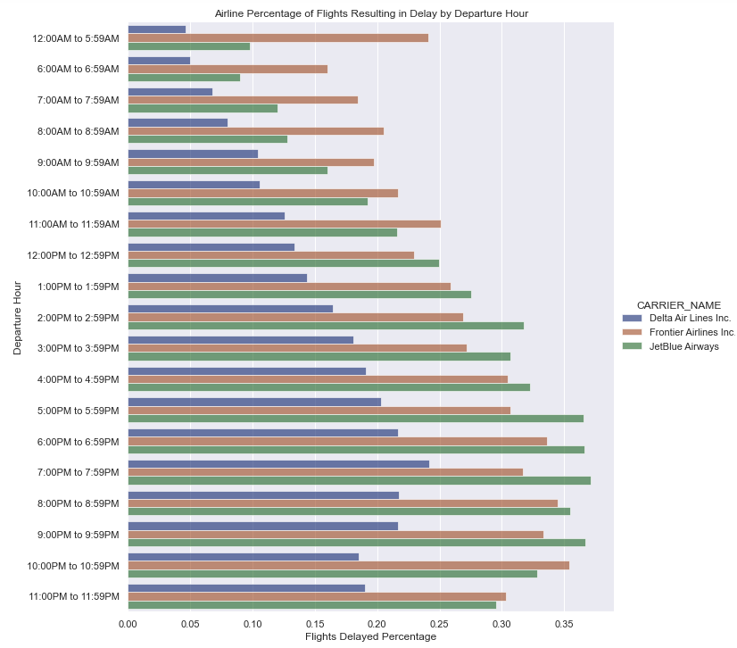
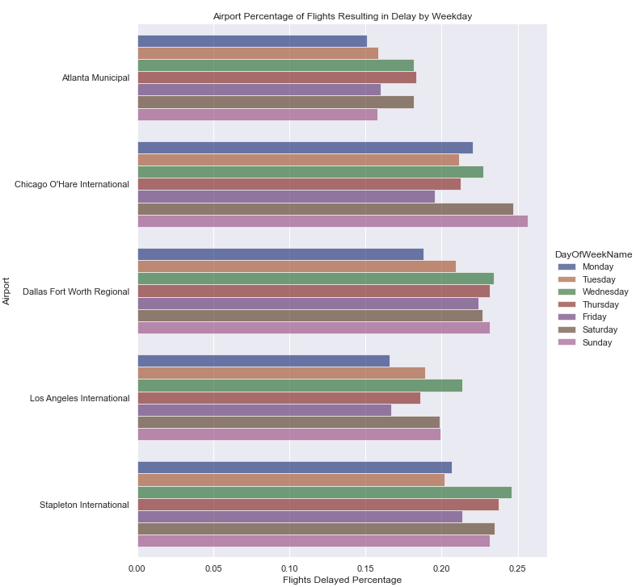
Data Understanding cont.
Heavy delay hours tend to vary between airlines
Airports tend to vary on heavy delay days of the week

Slide 10
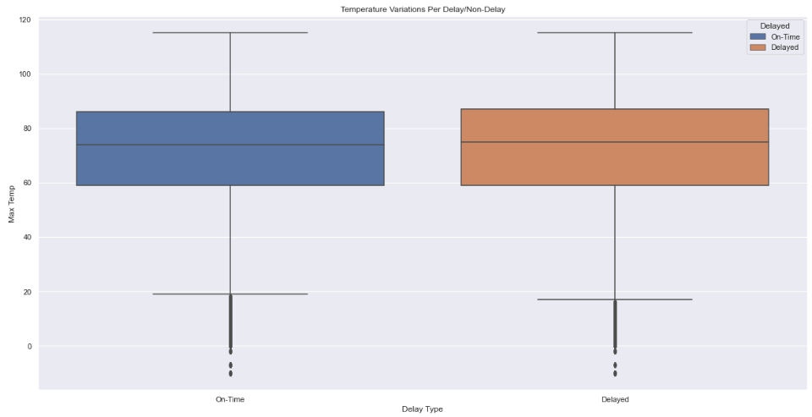
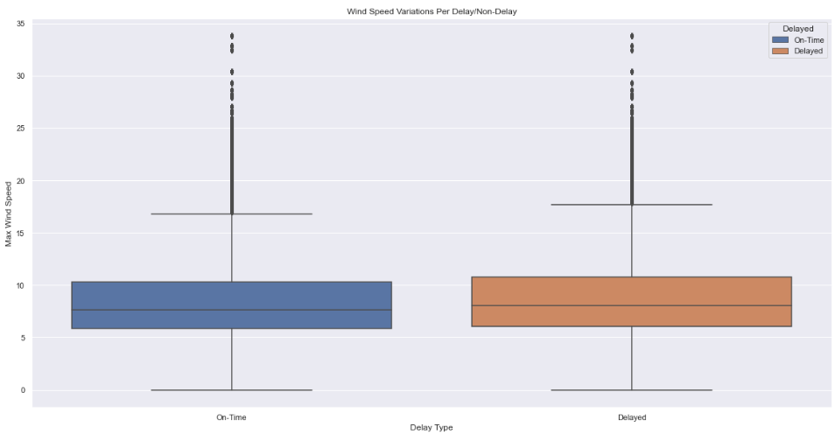
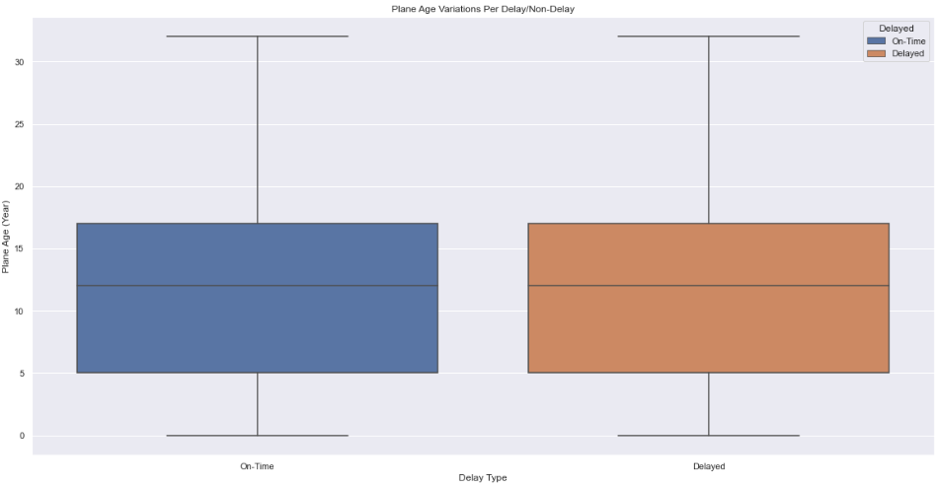
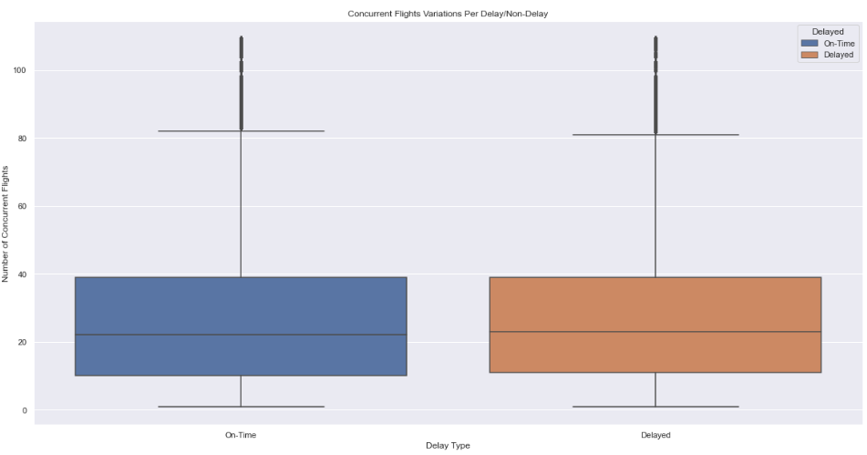
Data Understanding cont.
Temperature
Wind
Variations in temperature, wind, plane age, and concurrent flights tend to be nearly identical between on-time and delayed flights
Doesn’t give confidence in these variables as predictors
Contrast this to airport, airline, day of month, day of week, hour of day, which appeared to show potential as predictors
Plane Age
Concurrent Flights

Slide 11
Data Preparation
1.5GB Dataset
Combined Flight, weather, and manpower
Variable Transforms
Normalized quantitative variables
Dummy variables for categorical variables
Updated Month/Day variables for readability
Secondary Data Prep: Shockingly 1.5GB takes a REALLY long time to model.
Took a representative sample of data, 50K rows.
Processing Time Down, Days → Mins.
Notes:
This course is called ‘Big Data Analytics’

Slide 12
Model
Multiple Models were Explored
Logistical Regression
Decision Tree
Random Forest
Support Vector Machine (SVM)
K Nearest Neighbor (KNN)
Naïve Bayes
Multiple Metrics were Considered:
Accuracy
Precision
Recall
Data Used (80/20 Split)
50K Total
40K Trained
10K Test

Slide 13
Model Results (Single)
Metric Used: Precision (TP / (TP + FP))
Goal is to identify late flights accurately.
This way airports & airlines can try take swift action.
Initial Results
Metric | Data Set | Trivial | Logistic | Decision Tree | Random Forest | Support Vector Machine | K Nearest Neighbor | Naïve Bayes
Precision | ALL | 0% | 0% | 27.2% | 54% | 0% | 32.7% | 0%

Slide 14
Solution (Potential)
Consider the complexity the model is trying to predict
Daily Flights 45,000
Public Airports 5,211
Group III Airlines ($1B / yr) 19
Tested a multi-model solution to increase precision!
A collection of models to subdivides the data.
Each model trains with same variables but trains to specific subset of data

Slide 15
Model(s) Results (Uses Segmented Datasets)
Metric Used: Precision (TP / (TP + FP))
Data Set | Trivial | Logistic | Decision Tree | Random Forest | Support Vector Machine | K Nearest Neighbor | Naïve Bayes
ALL | 0% | 0% | 27.2% | 54.0% | 0% | 32.7% | 0%
1 | 0% | 0% | 29.6% | 67.5% | 0% | 45.3% | 27.7%
2 | 0% | 0% | 29.8% | 65.3% | 0% | 45.3% | 27.7%
3 | 0% | 0% | 22.1% | 49.5% | 0% | 29.4% | 20.0%
4 | 0% | 0% | 38.0% | 61.6% | 0% | 53.2% | 42%
5 | 0% | 0% | 32.6% | 54.0% | 0% | 53.2% | 0%
6 | 0% | 0% | 25.5% | 62.7% | 0% | 36.8% | 0%

Slide 16

Conclusion
National Late Flights
A BIG/Tough problem to tackle.
Models
Random Forest was okay
Multiple models were better.
Team #4:
Team learned a LOT!
Had fun coming up with solutions

Slide 17
Epilogue (I mean, why not!?)
The Pilot Program was a success!
Initially met with skepticism, customized models become industry standard.
In the next decade flight delays were diminished by 65%.
US(“startup”)
Startup no more, considered by many the premier data science company in the U.S.
Company Moto: We only model the most difficult things because, why not?!
Consistently wins multiple Kaggle competitions annually.
US(“startup”) Founders
All received A’s in the Big Data Analytics!
Instructor was quoted, “The only fault I could find in their ground breaking final report was that it was too perfect for words.” - 2028

Slide 18
Questions??
Notes:
Ryan

Slide 19
Thank You!!!
Notes:
Meichan

